Slide 1

Introduction
www.corvit.com

Slide 2
Topics
Course Outline
IT Infrastructure
SDLC
Waterfall vs Agile
Introduction to DevOps
DevOps Road Map
www.corvit.com

Slide 3
Course Outline
Introduction – 1
Ubuntu – 3
Network & Security – 2
AWS / Azure – 8
Scripting – 7
Servers – 3
Ansible – 2
www.corvit.com

Slide 4
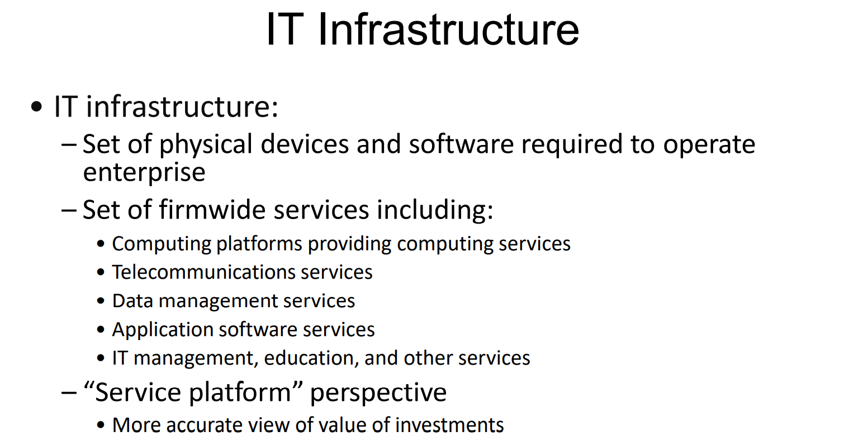
www.corvit.com

Slide 5

www.corvit.com

Slide 6

www.corvit.com

Slide 7
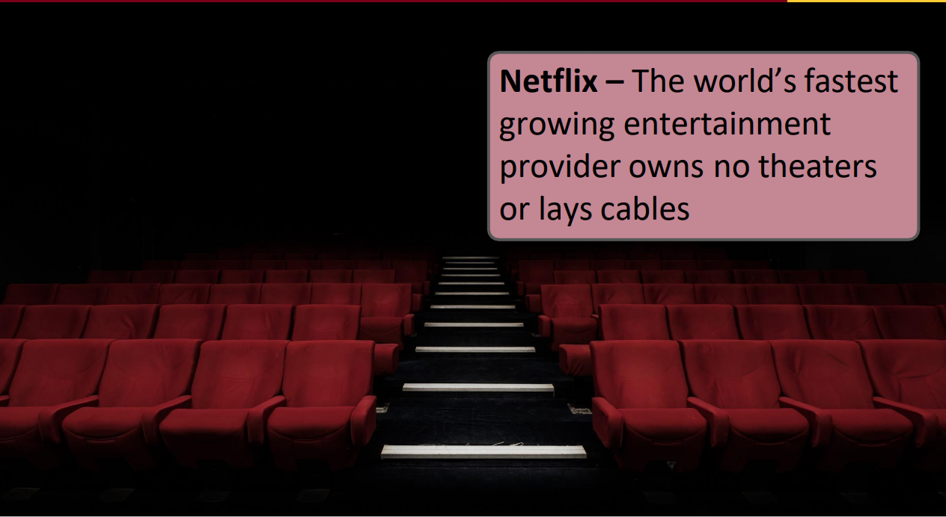
www.corvit.com

Slide 8
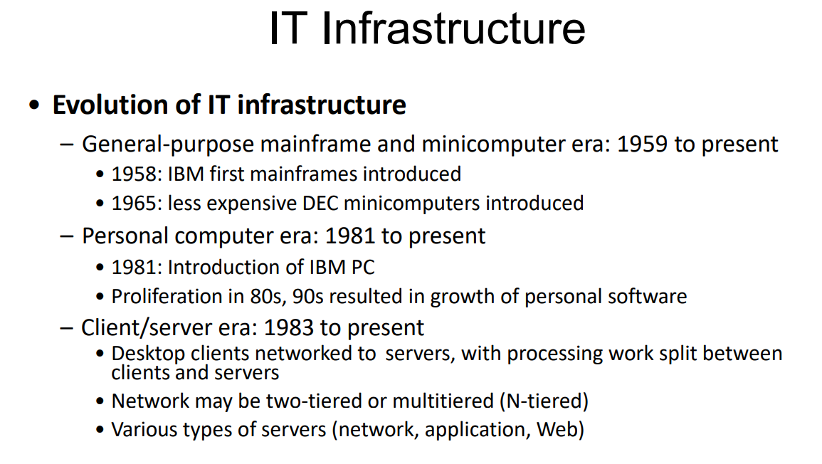
www.corvit.com

Slide 9
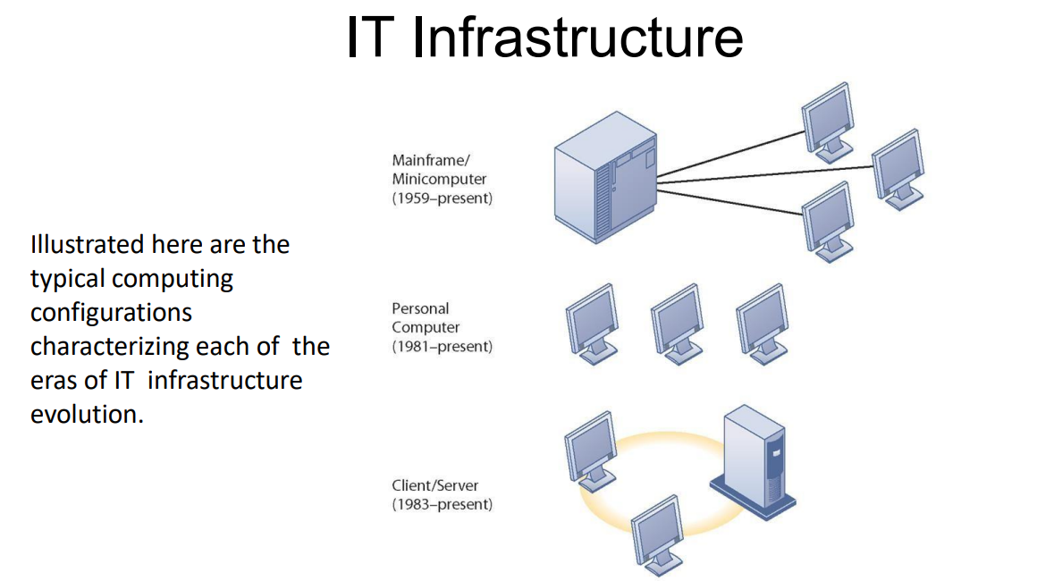
www.corvit.com

Slide 10
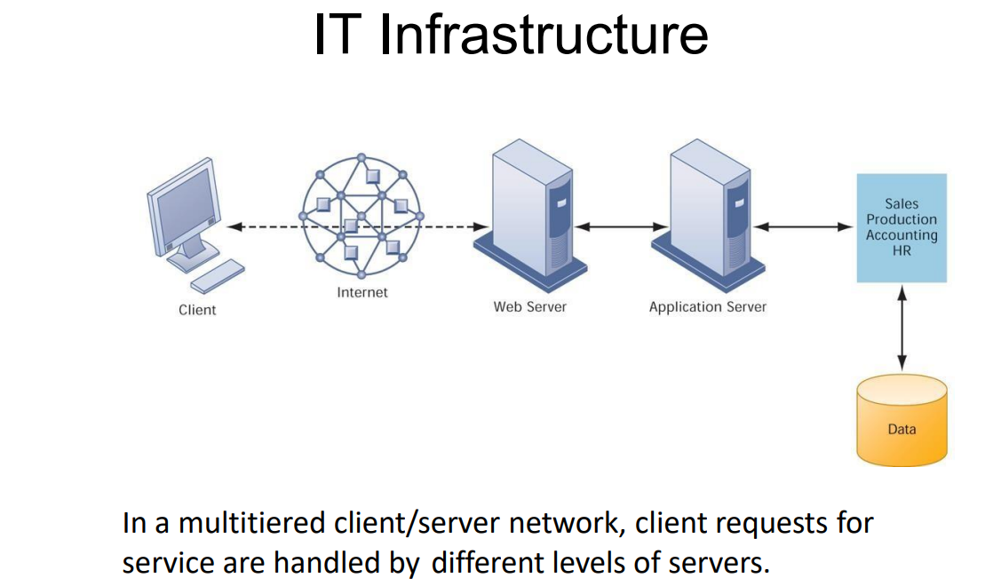
www.corvit.com

Slide 11
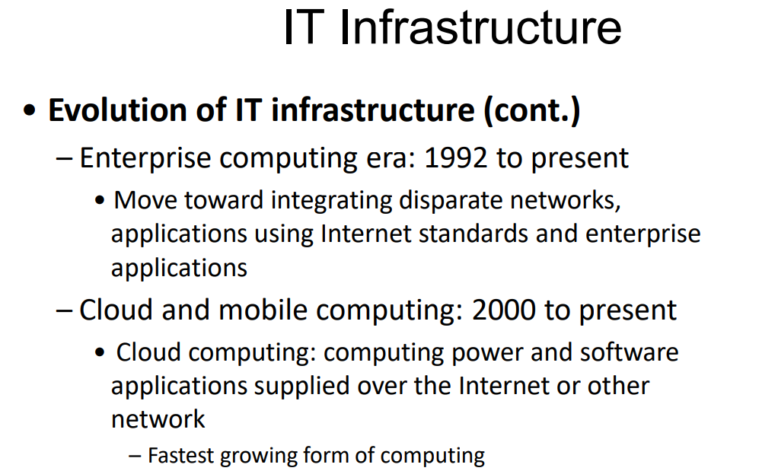
www.corvit.com

Slide 12
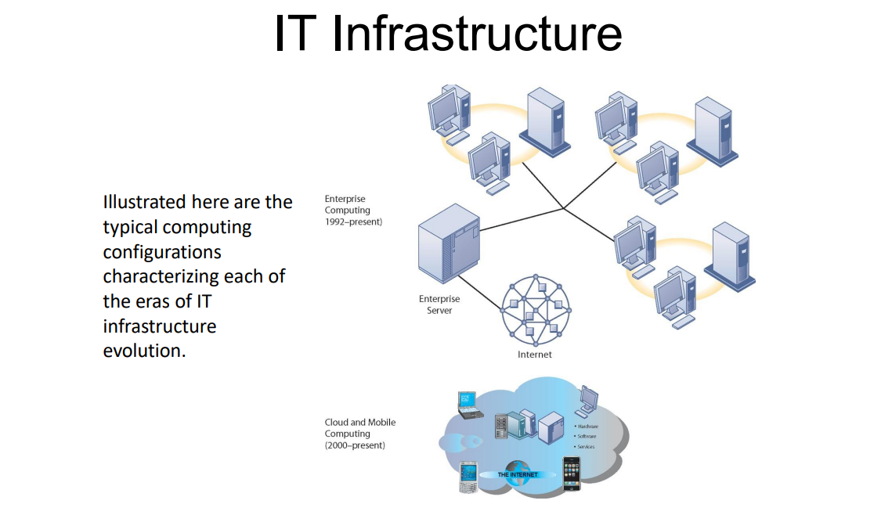
www.corvit.com

Slide 13
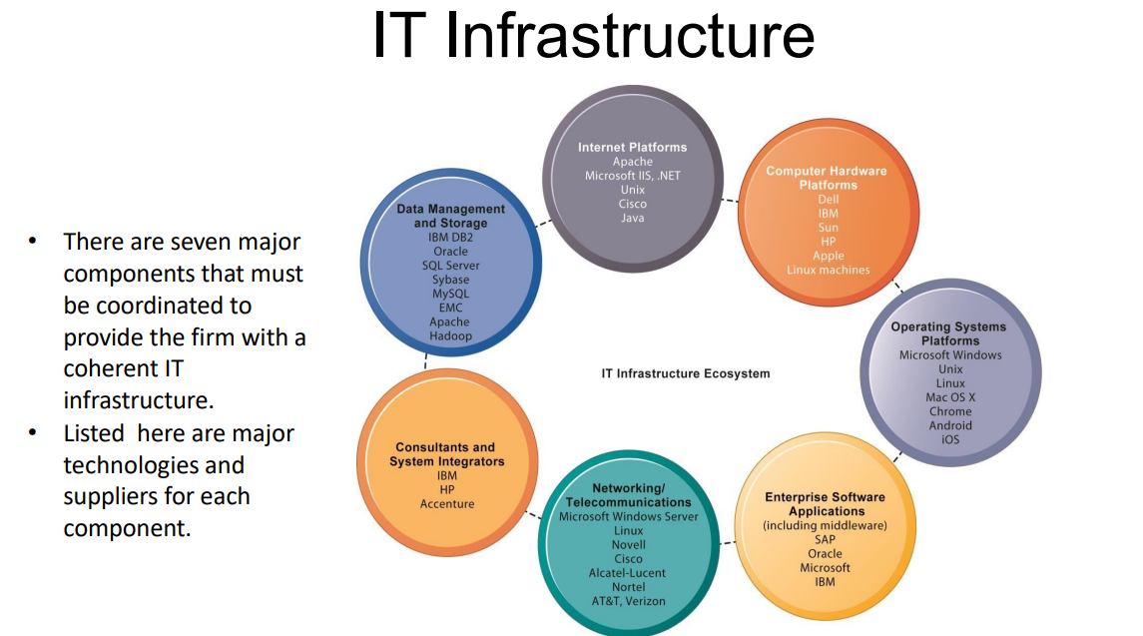
www.corvit.com

Slide 14
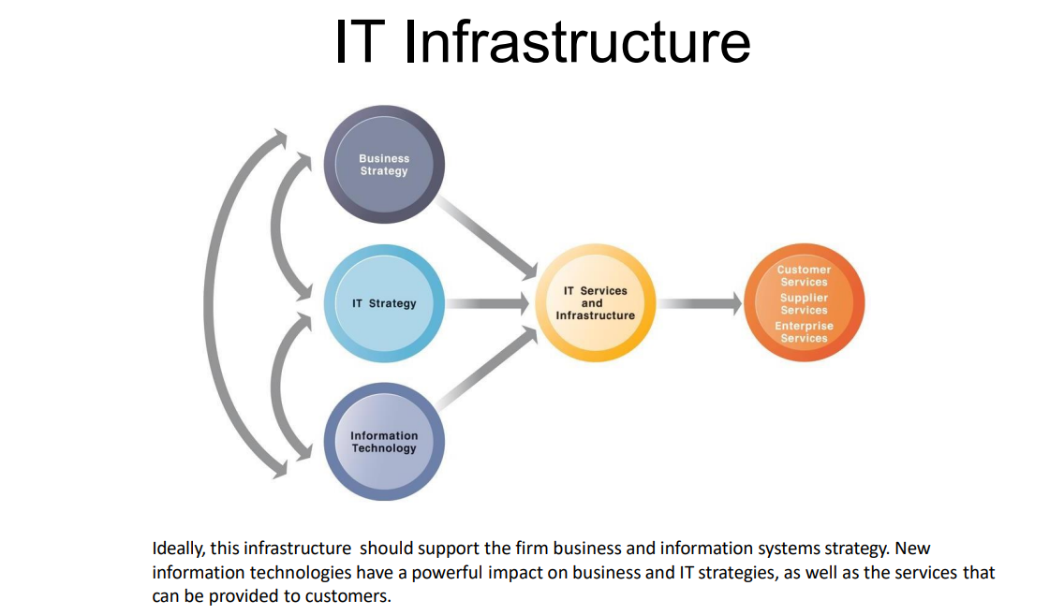
www.corvit.com

Slide 15
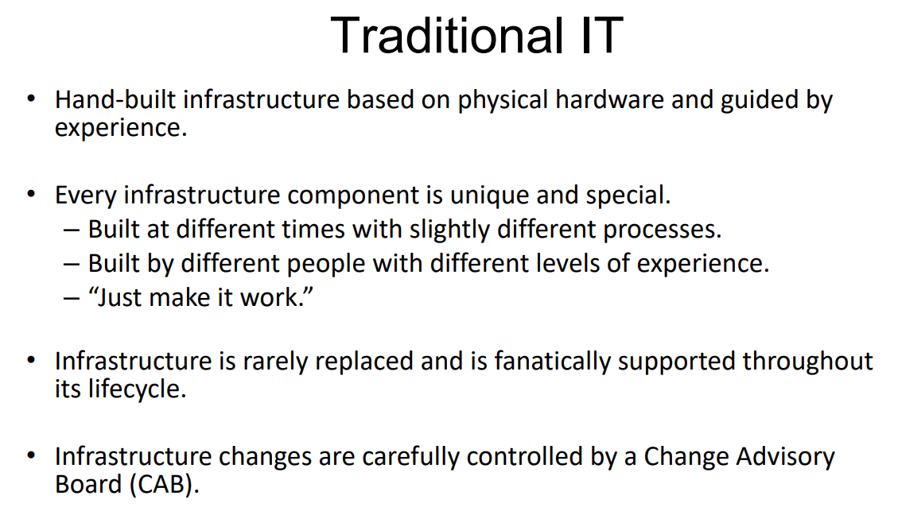
www.corvit.com

Slide 16
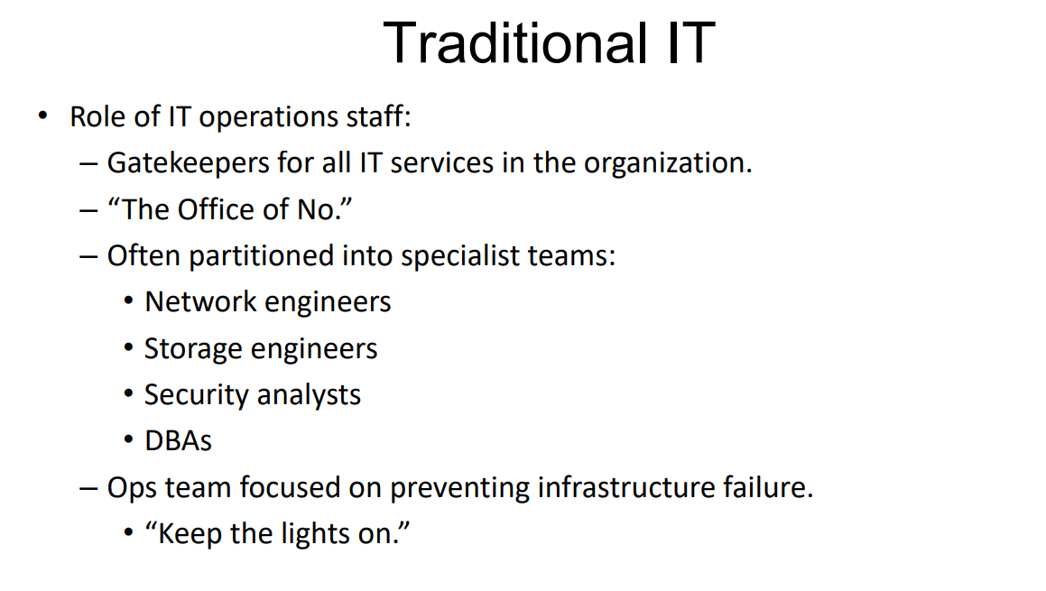
www.corvit.com

Slide 17
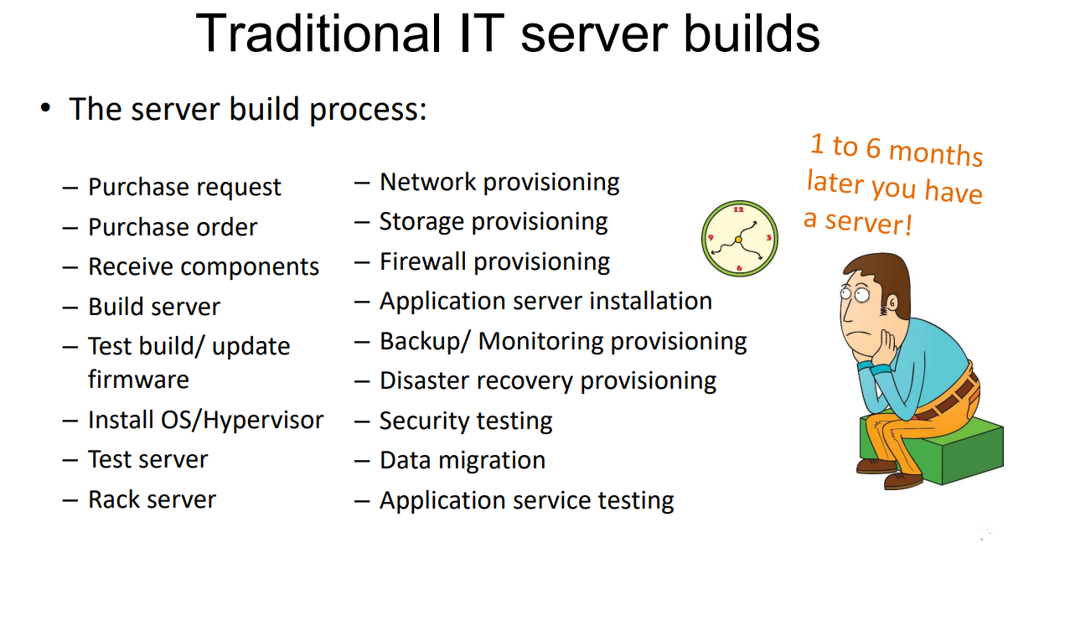
www.corvit.com

Slide 18
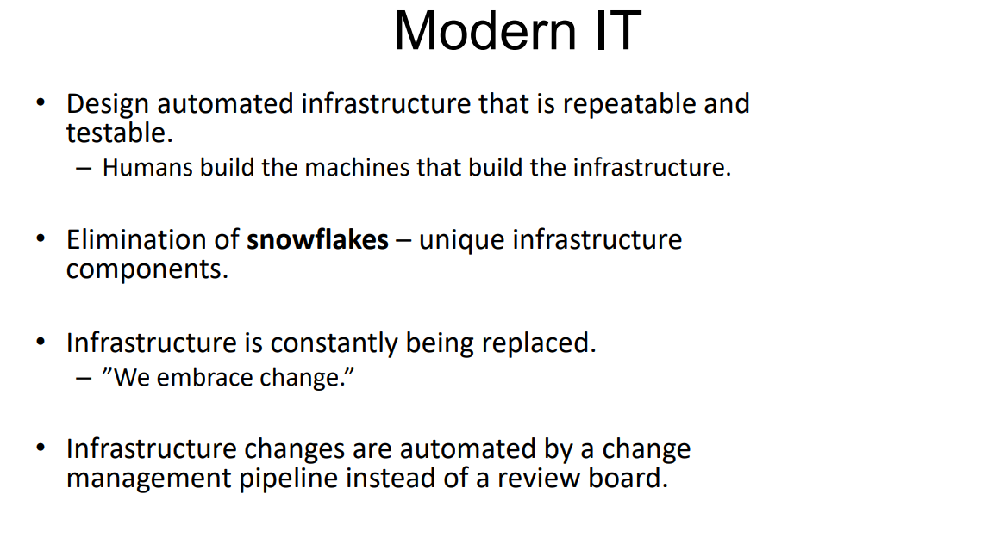
www.corvit.com

Slide 19
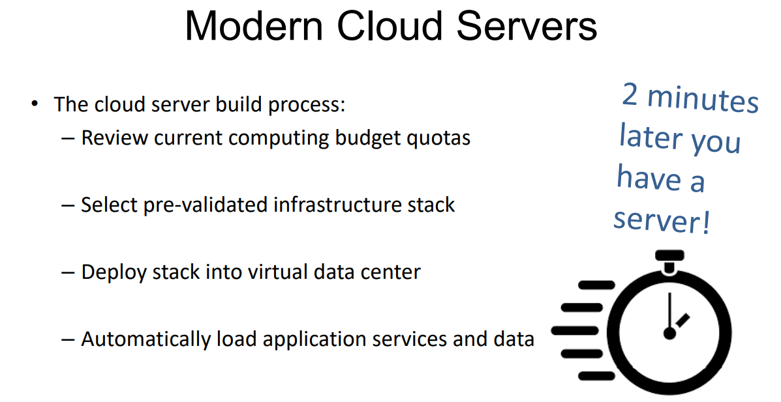
www.corvit.com

Slide 20
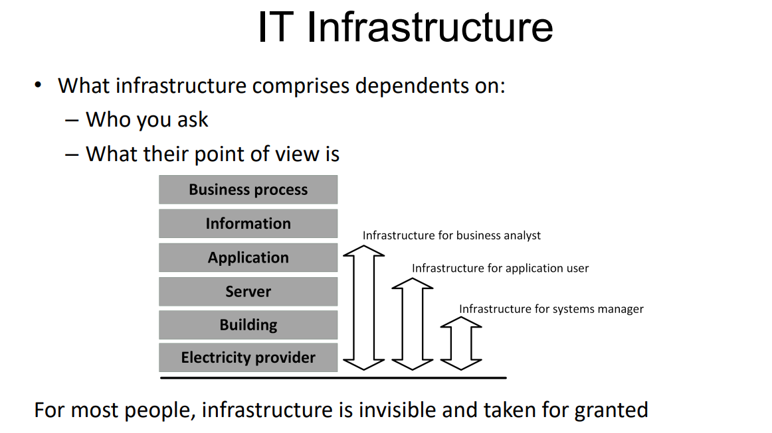
www.corvit.com

Slide 21
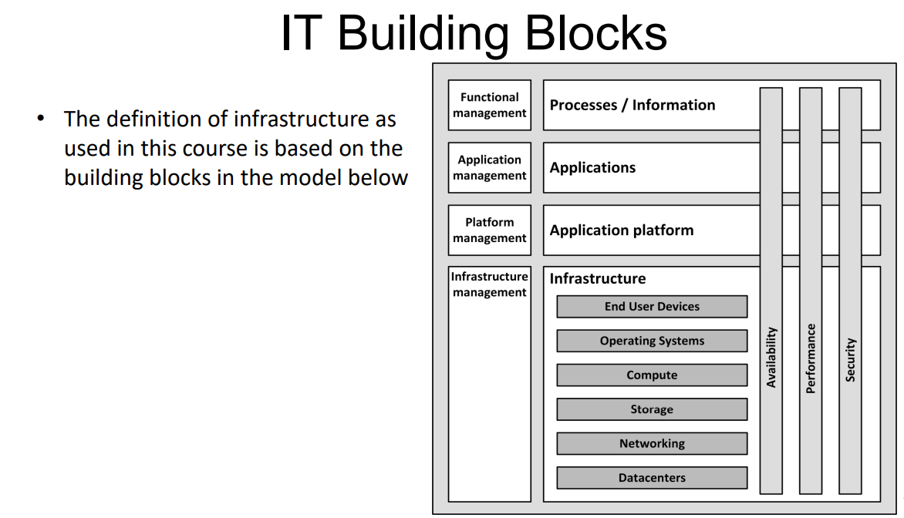
www.corvit.com

Slide 22
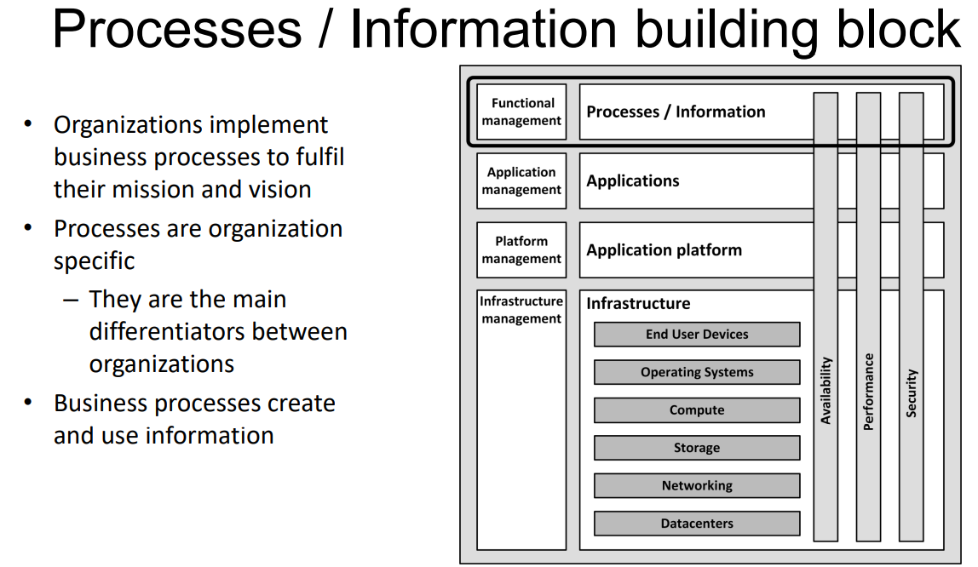
www.corvit.com

Slide 23
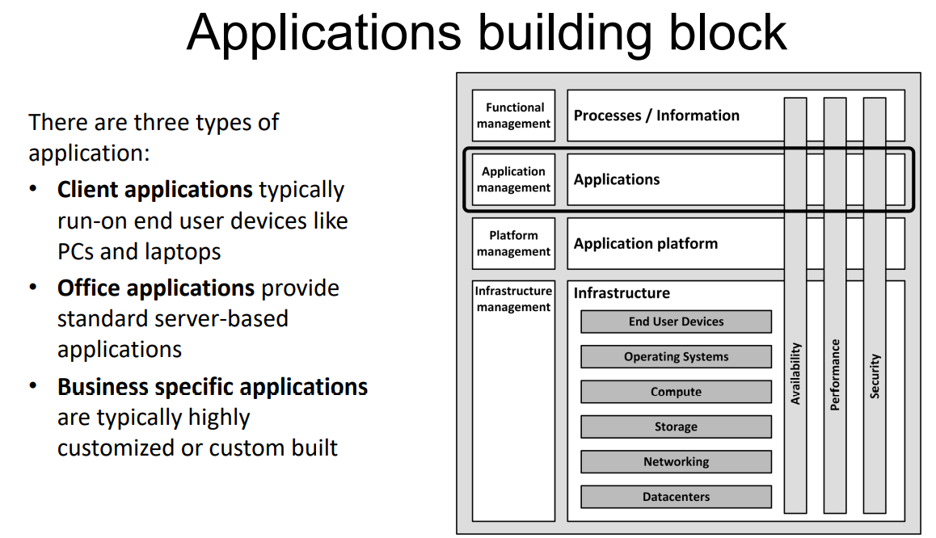
www.corvit.com

Slide 24
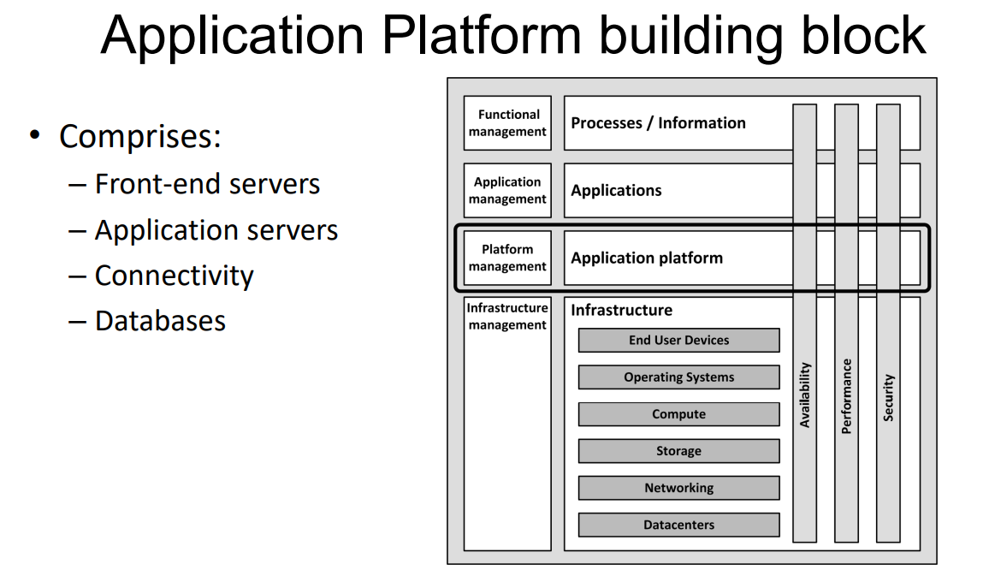
www.corvit.com

Slide 25
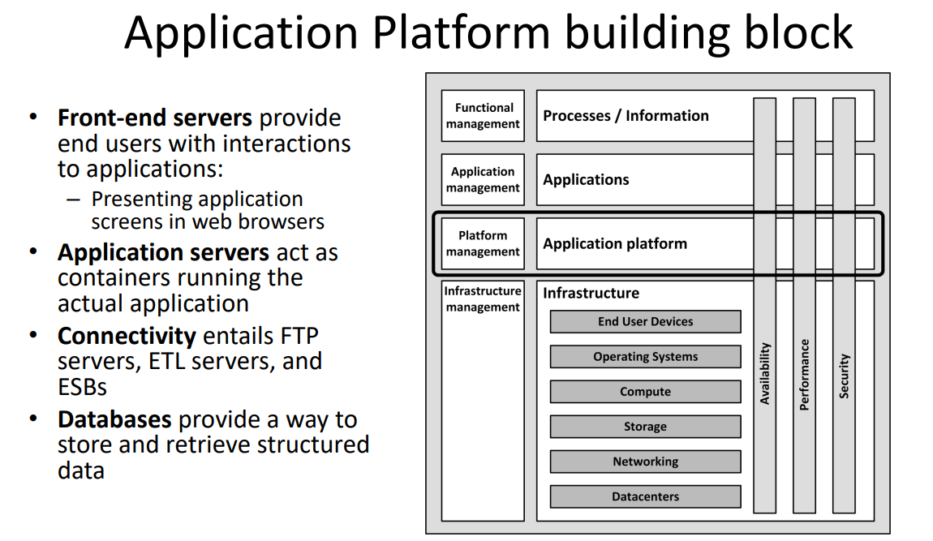
www.corvit.com

Slide 26
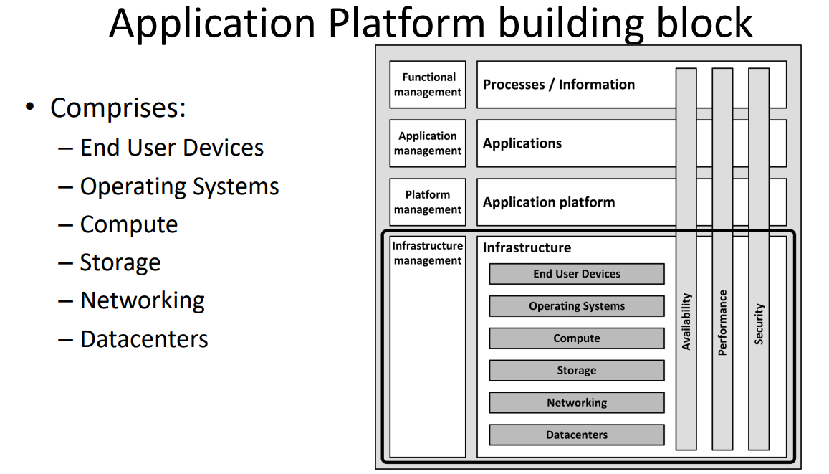
www.corvit.com

Slide 27
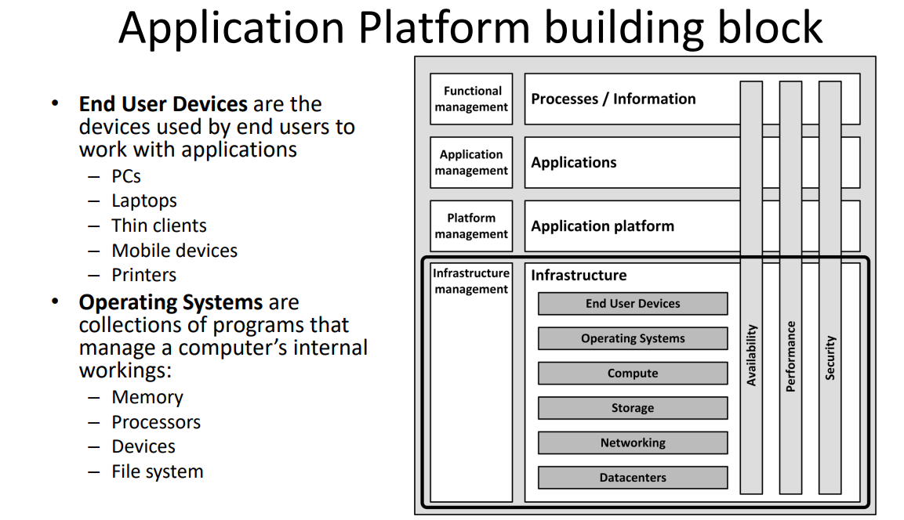
www.corvit.com

Slide 28
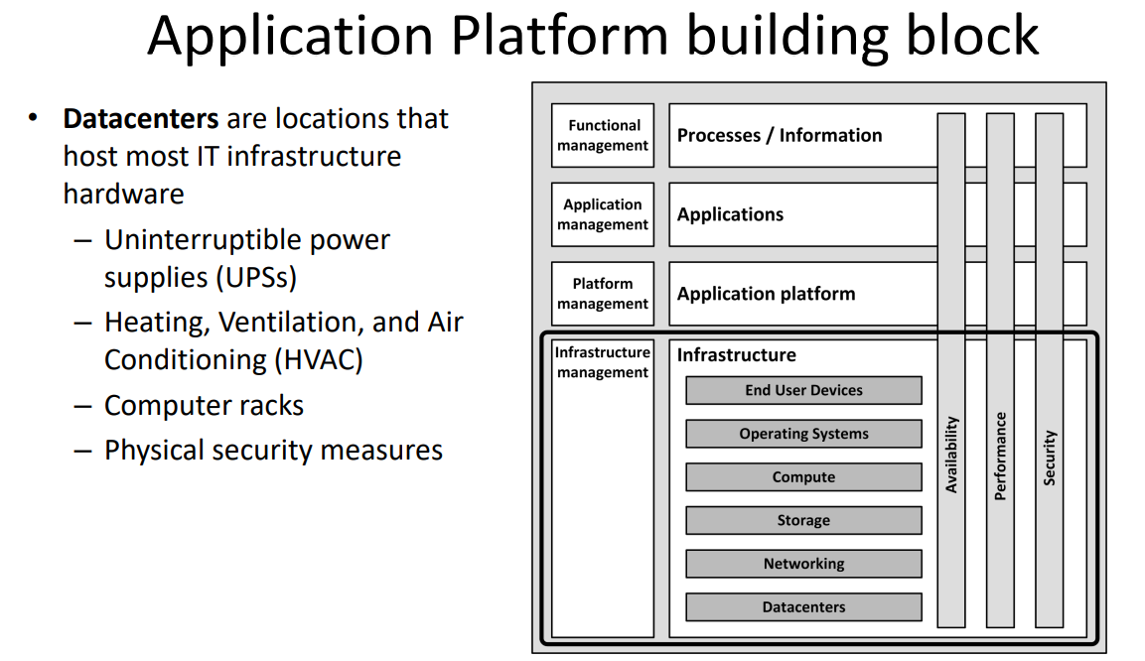
www.corvit.com

Slide 29
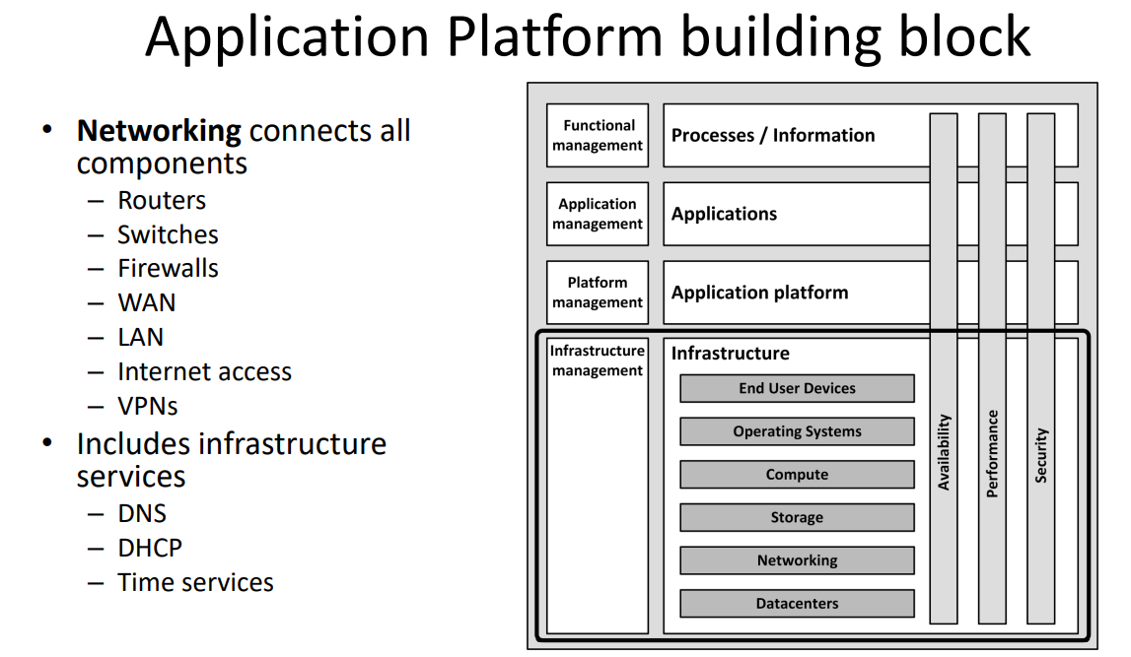
www.corvit.com

Slide 30
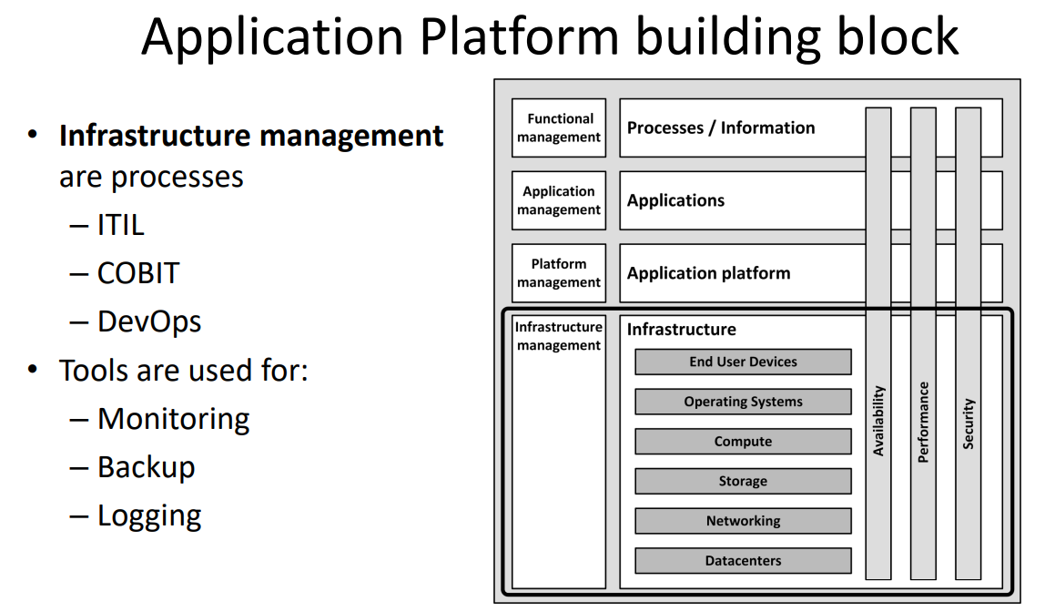
www.corvit.com

Slide 31
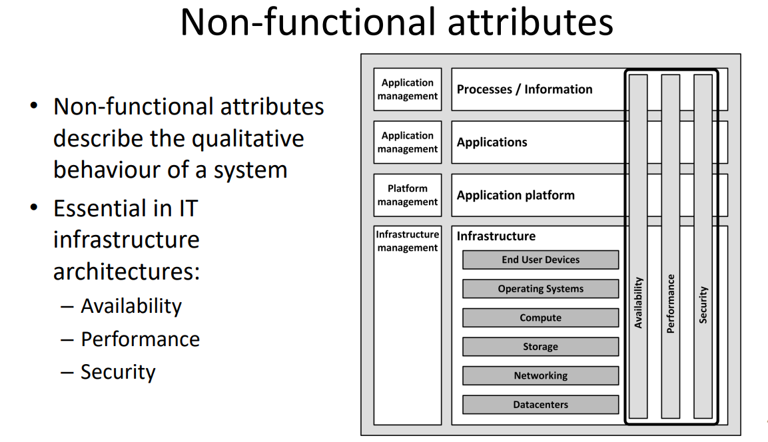
www.corvit.com

Slide 32
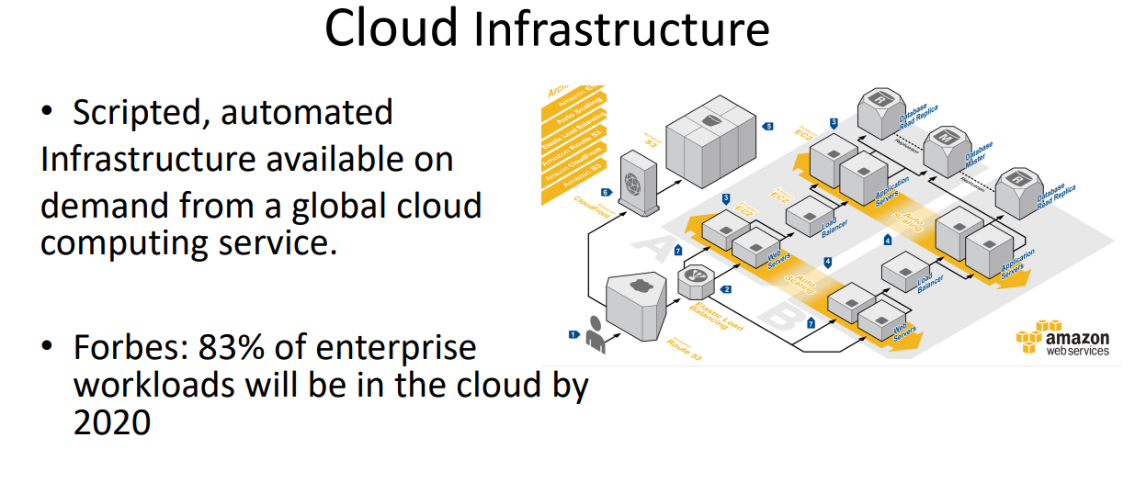
www.corvit.com

Slide 33
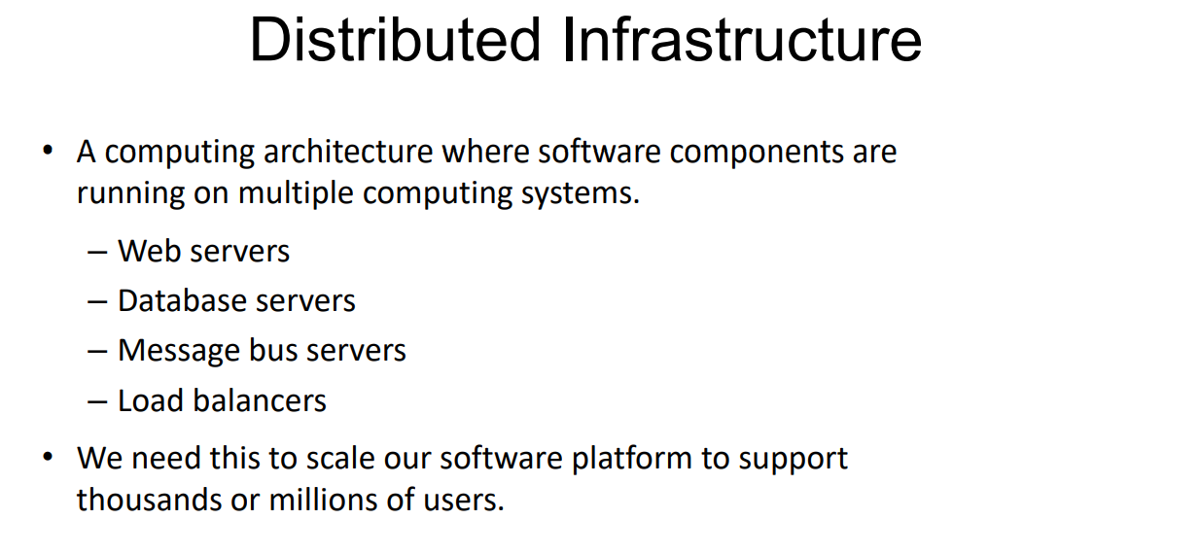
www.corvit.com

Slide 34
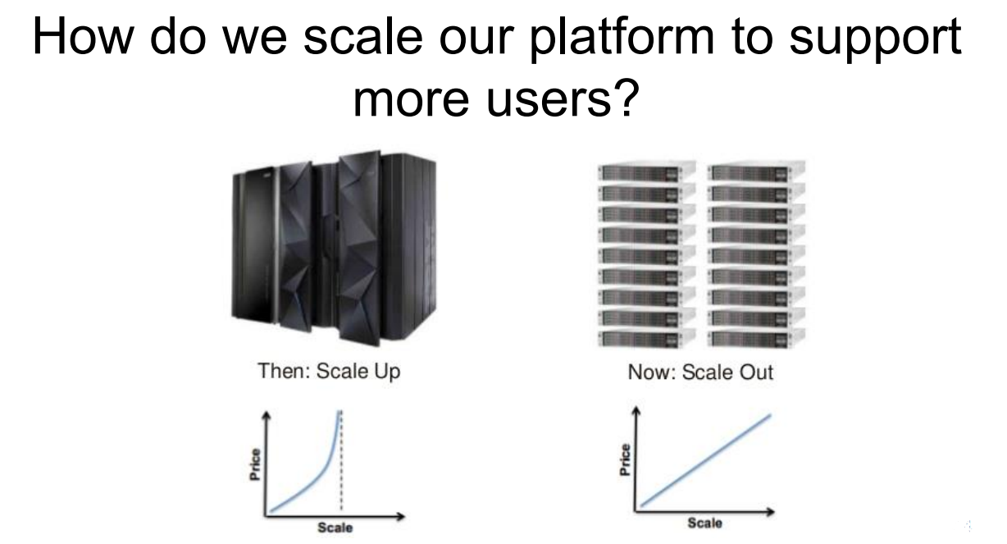
www.corvit.com

Slide 35
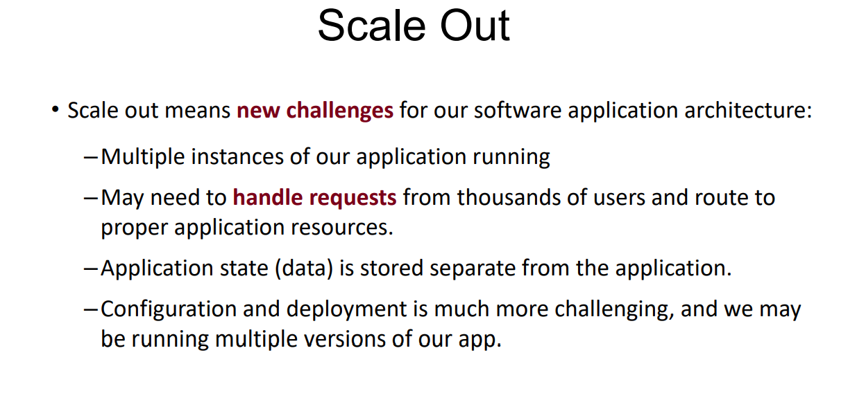
www.corvit.com

Slide 36
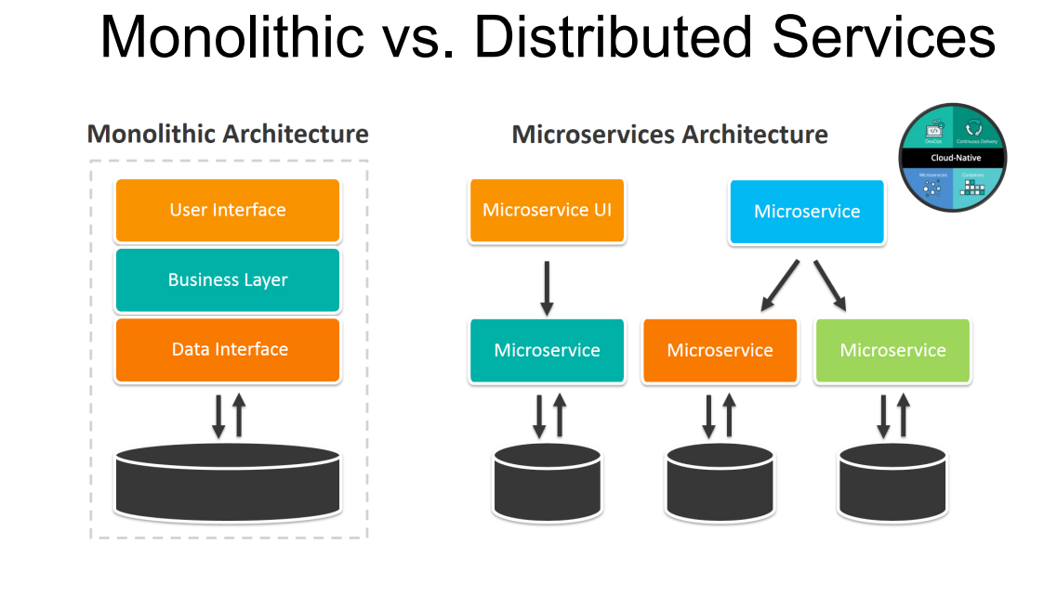
www.corvit.com

Slide 37
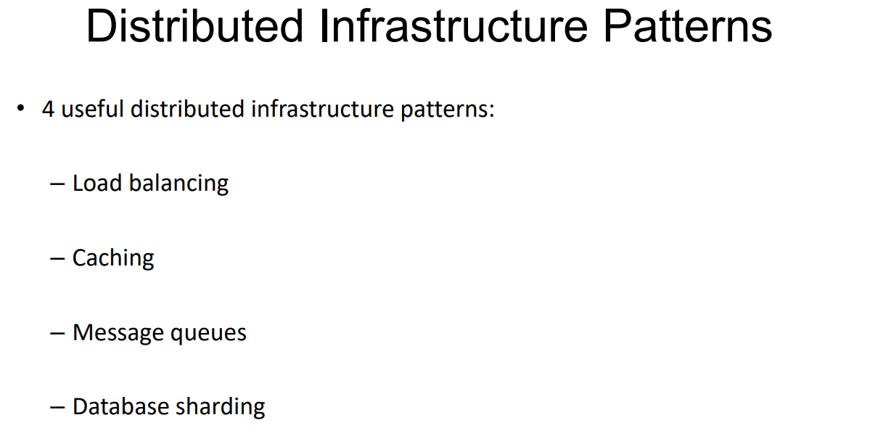
www.corvit.com

Slide 38
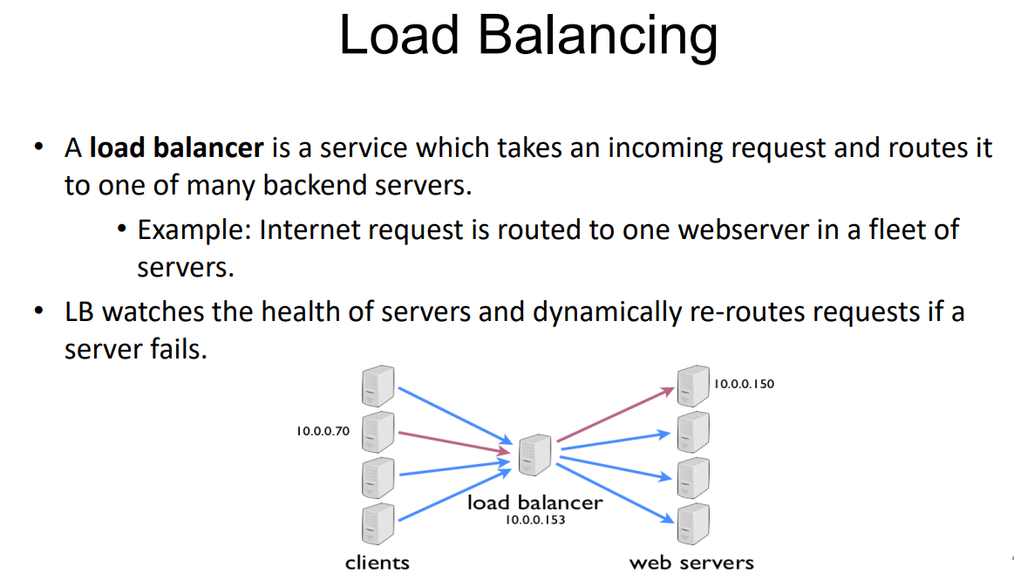
www.corvit.com

Slide 39
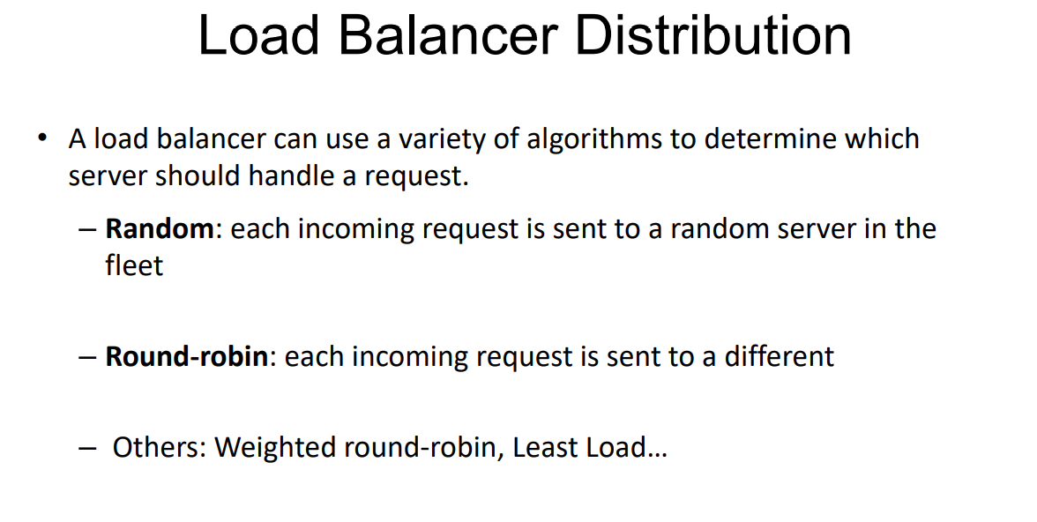
www.corvit.com

Slide 40
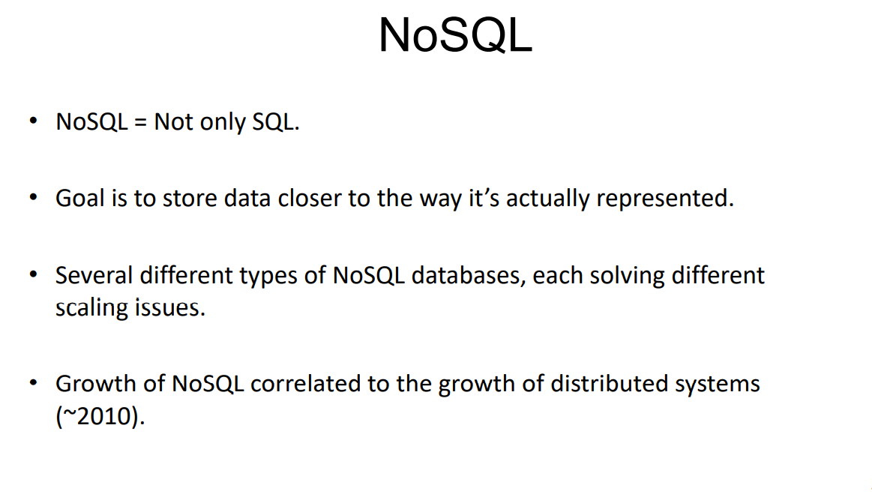
www.corvit.com

Slide 41
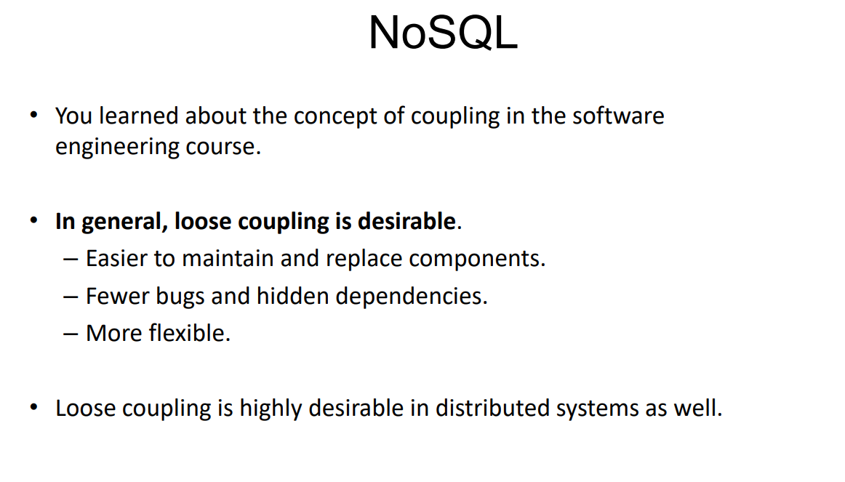
www.corvit.com

Slide 42
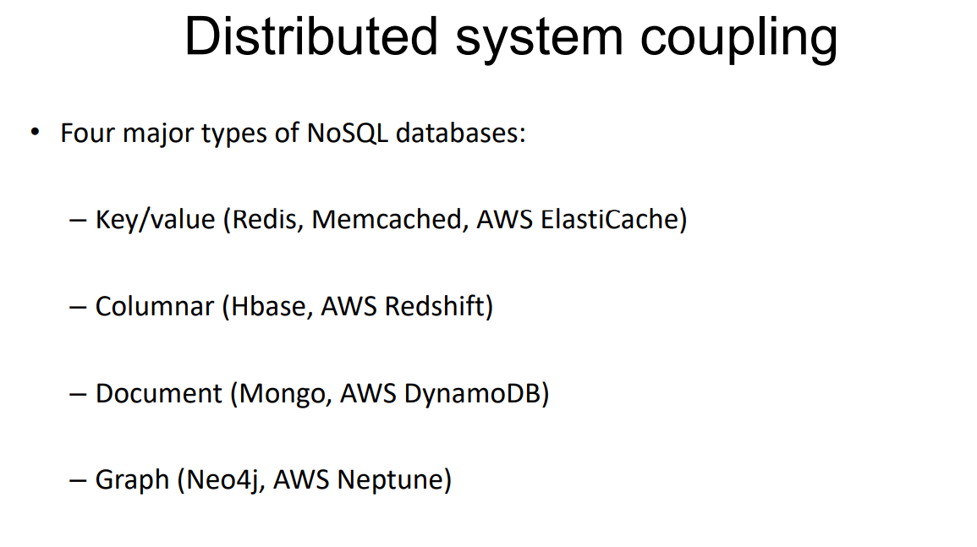
www.corvit.com

Slide 43
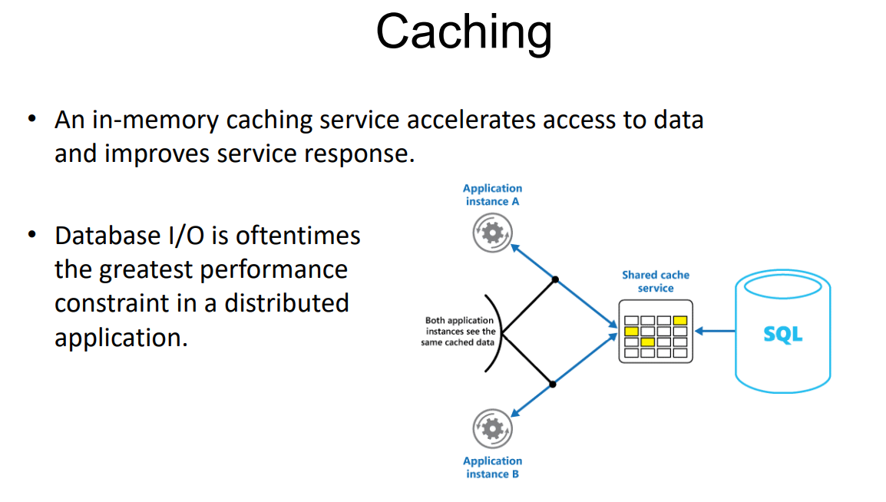
www.corvit.com

Slide 44
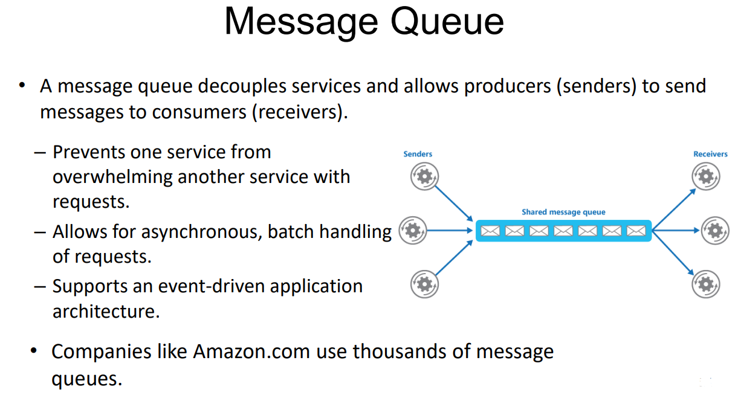
www.corvit.com

Slide 45
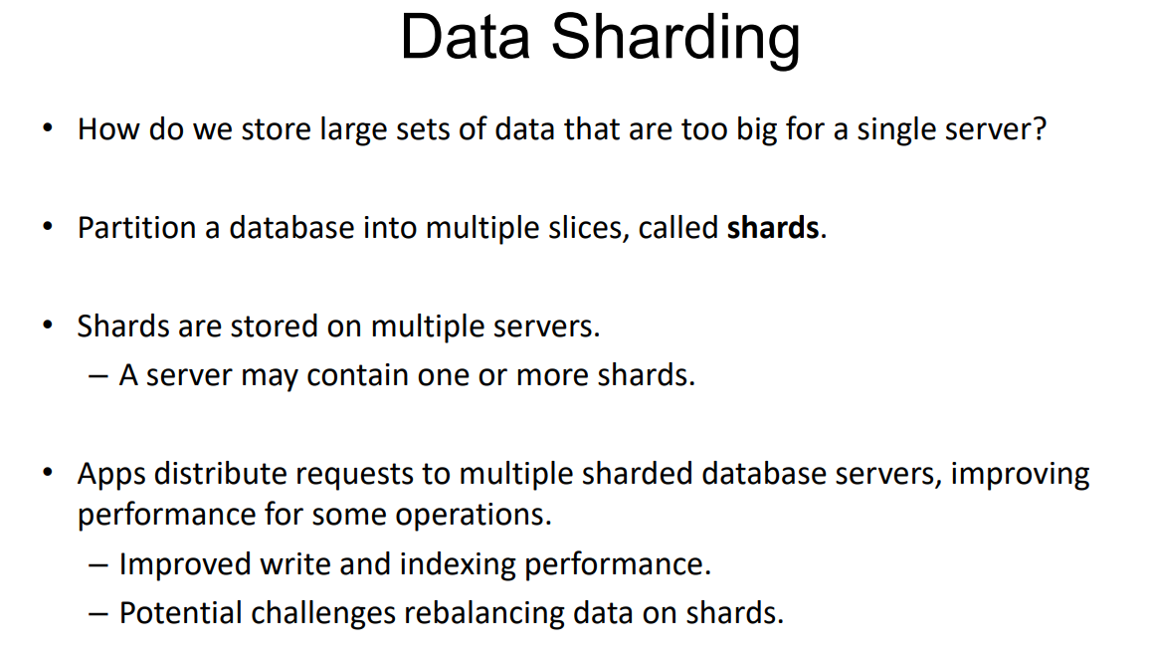
www.corvit.com

Slide 46
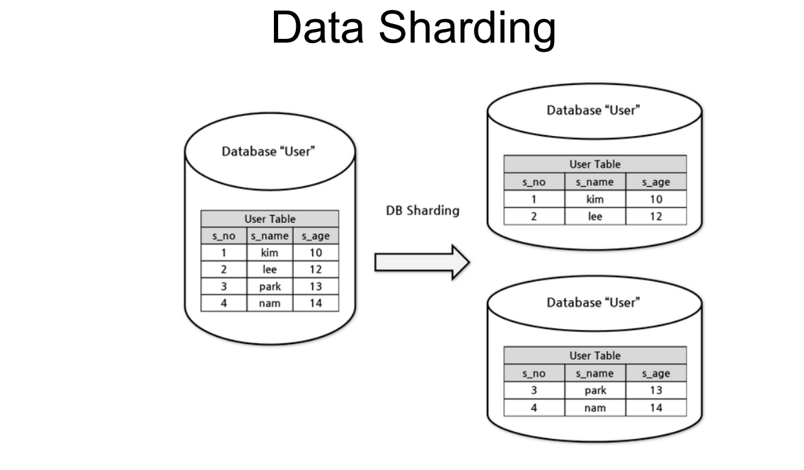
www.corvit.com

Slide 47
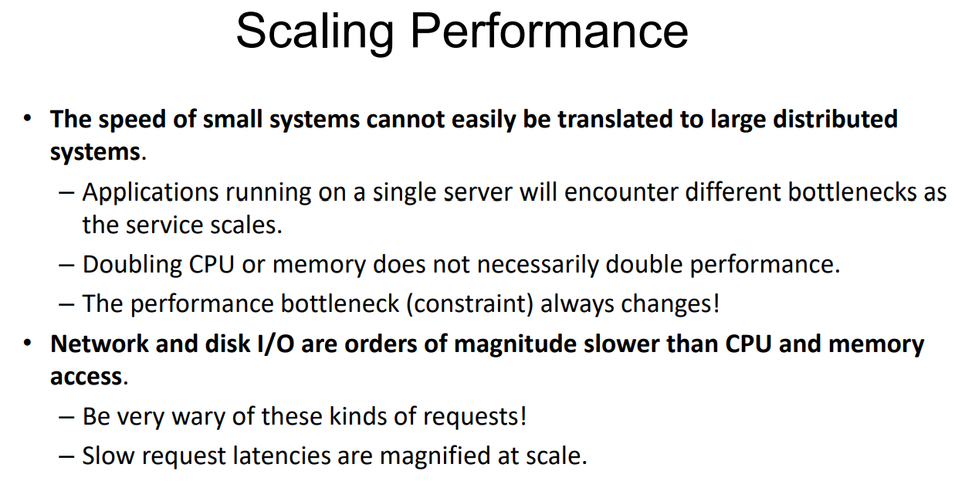
www.corvit.com

Slide 48
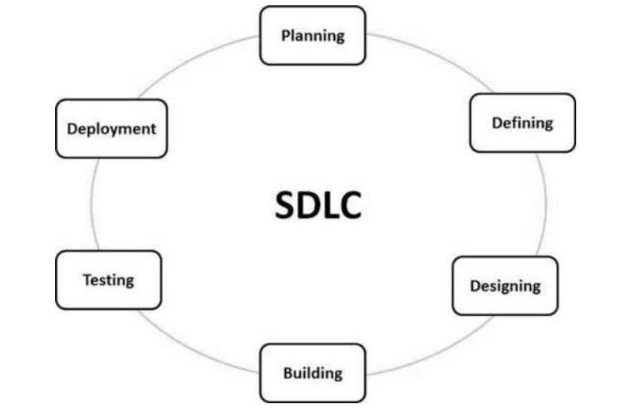
www.corvit.com

Slide 49
SDLC Models/Methodologies
Waterfall Model
Agile
Waterfall represents the oldest, simplest, and most structured methodology. Each phase depends on the outcome of the previous phase, and all phases run sequentially. This model provides discipline and gives a tangible output at the end of each phase. However, this model doesn’t work well when flexibility is a requirement. There is little room for change once a phase is deemed complete, as changes can affect the cost, delivery time, and quality of the software.
The agile methodology produces ongoing release cycles, each featuring small, incremental changes from the previous release. At each iteration, the product is tested. The agile model helps teams identify and address small issues in projects before they evolve into more significant problems. Teams can also engage business stakeholders and get their feedback throughout the development process.
www.corvit.com

Slide 50
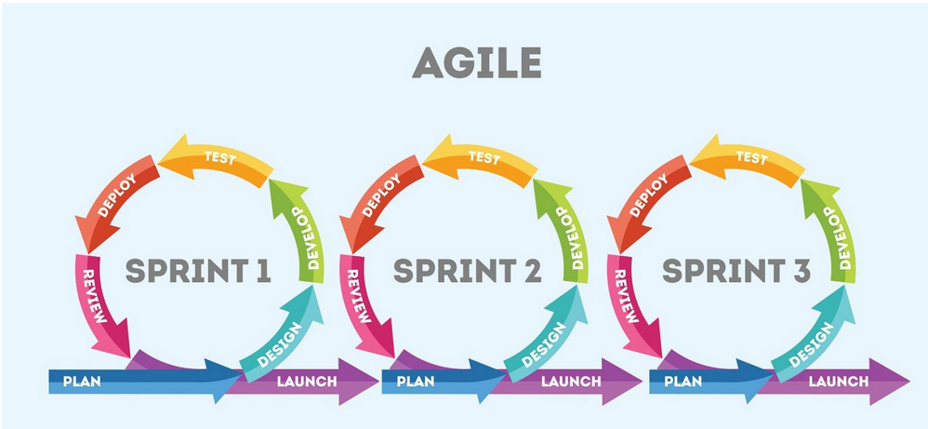
www.corvit.com

Slide 51
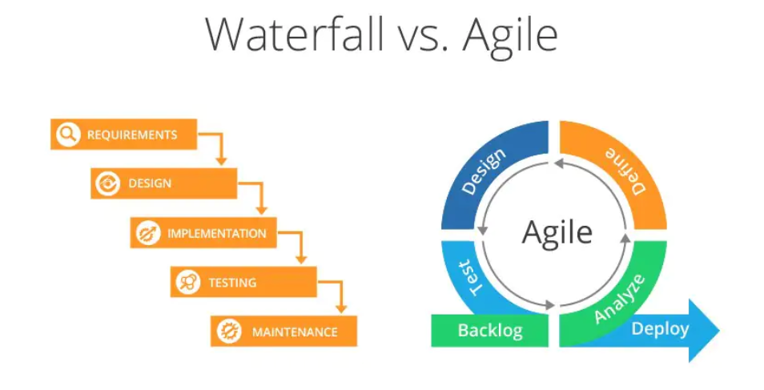
www.corvit.com

Slide 52
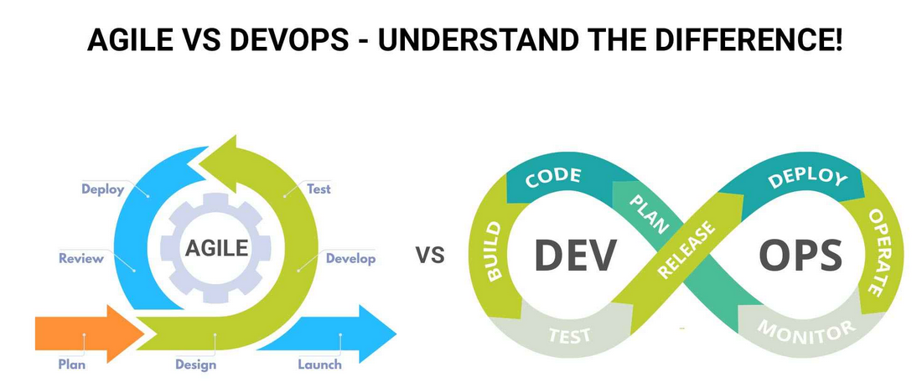
What is DevOps?
DevOps is a set of practices that combines software development and IT operations. It aims to shorten the systems development life cycle and provide continuous delivery with high software quality. DevOps is complementary to agile software development; several DevOps aspects came from the agile way of working.
www.corvit.com

Slide 53
Agile vs DevOps – Key Differences
Agile
DevOps
Focus on quicker reaction time
Agile sees individuals responsible for different roles throughout the process
Looks at software development
Agile is more well known for lean-approach
The agile approach works in sprints, which can have durations ranging from a week to about a month
An agile approach is also geared for fluctuating change
Focus on quicker release times
DevOps team is accountable for everything
Looks at providing sequential business solutions at a rapid pace
For DevOps, it’s more about reducing costs
On the other hand, DevOps emphasizes may have released several times a day.
DevOps places emphasis on regular testing and delivery
www.corvit.com

Slide 54
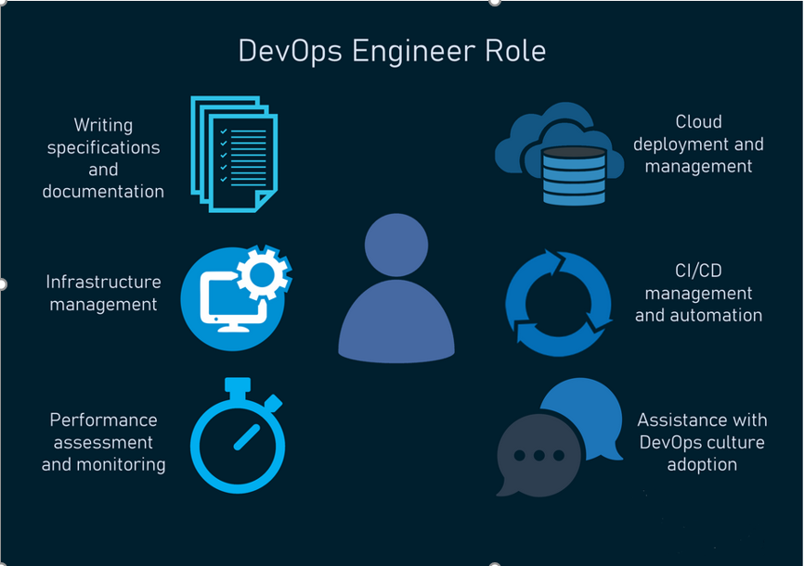
www.corvit.com

Slide 55
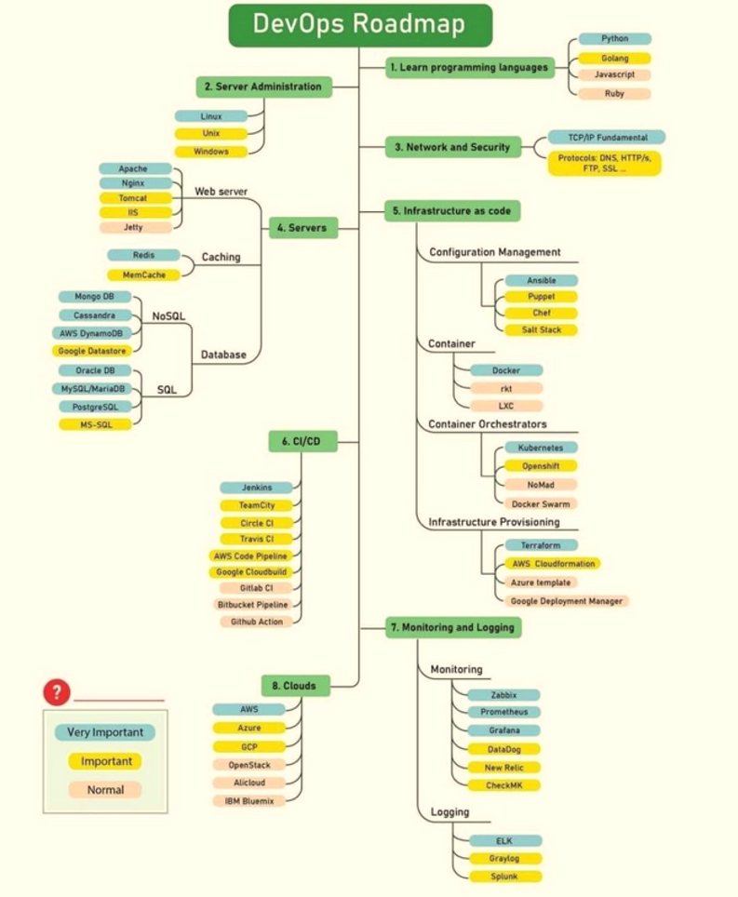
www.corvit.com

